Slide 1
DROUGHT
General Science & Ability

Slide 2
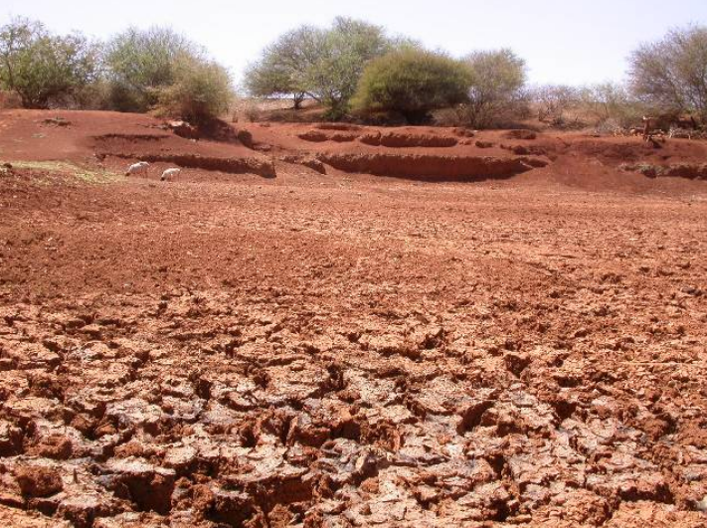
DROUGHT
General Science & Ability

Slide 3
What will be studied in this lecture.
Definition
Fresh Water Availability Per Human
What are the Causes of Drought
What are the effects of Drought on humans
Strategies to manage droughts

Slide 4
Definition
Drought is defined as a deficiency of rainfall over an extended period – a season, a year or several years – relative to the statistical multi-year average for the region resulting in prolonged shortages in its water supply.

Slide 5
Drought is…
Water
Demand
Water
Supply

Slide 6
Freshwater availability scenario (Per person)
Global
1950 – 16,800 cubic meters per annum
2000 – 6,800 cubic meters per annum
Reduction: 60 % in 50 years
Pakistan
1950 – 5,300 cubic meters per annum
2000 – 1,200 cubic meters per annum !!!!
Reduction: 77 % in 50 years
Critical limit 1,000 cubic meters per person per annum

Slide 7
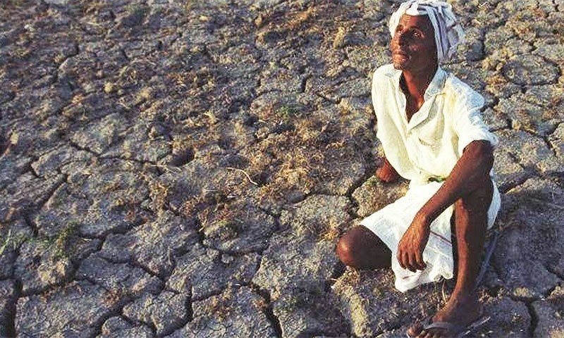
Causes
Lack of Rainfall (or precipitation):
Dry Season
Surface water flow (streams and Rivers)
Deforestation
Global warming

Slide 8
Human factors
Over mining
Population increasing
Overgrazing
Cutting Irregularly

Slide 9
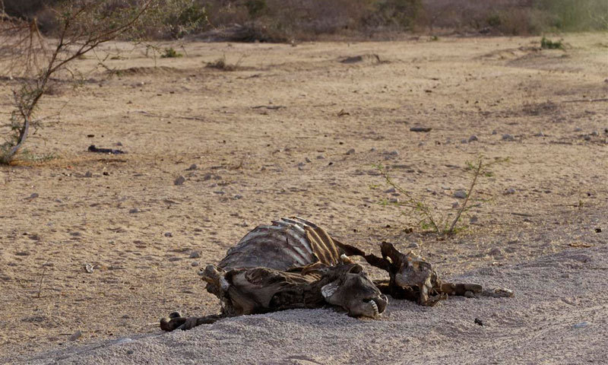
Effects
Diminished crop growth or yield productions and carrying capacity for livestock
Food Shortage and Famine due to lack of water for irrigation
Desertification
Habitat damage, affecting both terrestrial and aquatic wildlife
Hunger, drought provides too little water to support food crops.

Slide 10
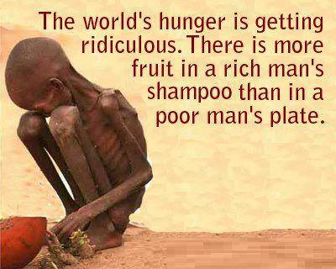
Effects
Malnutrition, dehydration and related diseases
Mass migration, resulting in internal displacement
international refugees crisis
wildlife migration
Social unrest and conflict over natural resources

Slide 11
Effects
War over natural resources, including water and food
Wildfires bushfires, are more common during times of drought
Death of people and animals
Economic losses

Slide 12
Strategies to manage droughts
Strategies for drought protection, mitigation or relief include:
Dams - many dams and their associated reservoirs supply additional water in times of drought
Desalination - of sea water for irrigation or consumption.
Drought monitoring - Continuous observation of rainfall levels and comparisons with current usage levels can help prevent man-made drought.
Land use - Carefully planned crop rotation can help to minimize erosion and allow farmers to plant less water-dependent crops in drier years.
Cloud seeding - a form of intentional weather modification to induce rainfall.

Slide 13
Strategies
Outdoor water-use restriction - Regulating the use of sprinklers, hoses or buckets on outdoor plants, filling pools, and other water-intensive home maintenance tasks.
Rainwater harvesting - Collection and storage of rainwater from roofs or other suitable catchments.
Recycled water - Former wastewater (sewage) that has been treated and purified for reuse.
Redirecting rivers - Building canals or redirecting rivers as massive attempts at irrigation in drought-prone areas.

Slide 14
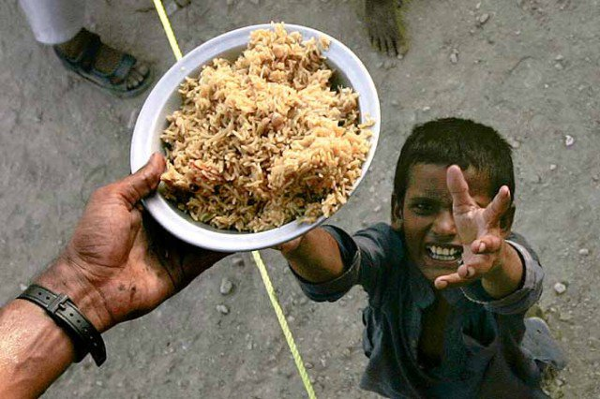
Reduce poverty

