Slide 1
Non Renewable & Renewable Energy Resources
General Science & Ability
For CSS and PMS

Slide 2
NONRENEWABLE RESOURCES
A nonrenewable resource is a natural resource that cannot be re-made or re-grown at a scale comparable to its consumption.

Slide 3
NUCLEAR ENERGY
Nuclear fission uses uranium to create energy.
Nuclear energy is a nonrenewable resource because once the uranium is used, it is gone!

Slide 4
COAL, PETROLEUM, AND GAS
Coal, petroleum, and natural gas are considered nonrenewable because they can not be replenished in a short period of time. These are called fossil fuels.

Slide 5
HOW IS COAL MADE ???
Notes:
SWAMP: SUBMERGED

Slide 6
Types of Coal
There are deferent types of Coal according to percentage of carbon.
Higher the percentage of carbon, better the quality.
Types:
Peat
Lignite
Bituminous and anthracite
Peat is least quality and Anthracite is best quality coal.
If coal is compress and heated more then it converts to graphite, a purest form of carbon or coal.

Slide 7
HOW ARE OIL AND GAS MADE ???

Slide 8
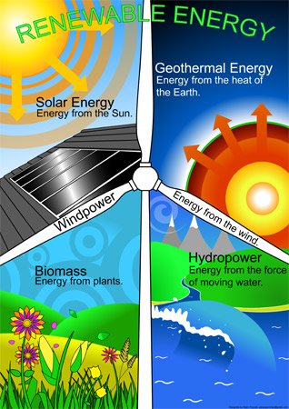
RENEWABLE RESOURCES
Renewable resources are natural resources that can be replenished in a short period of time.

Slide 9
SOLAR
Energy from the sun.
Why is energy from the sun renewable?

Slide 10
GEOTHERMAL
Energy from Earth’s heat.
Why is energy from the heat of the Earth renewable?

Slide 11
WIND
Energy from the wind.
Why is energy from the wind renewable?

Slide 12
BIOMASS
Energy from burning organic or living matter.
Why is energy from biomass renewable?

Slide 13
WATER or HYDROELECTRIC
Energy from the flow of water.
Why is energy of flowing water renewable?

Slide 14
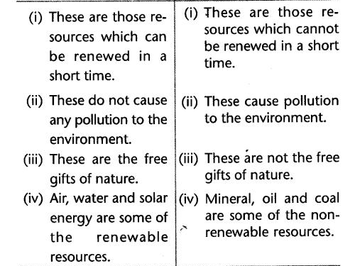
Renewable vs Non Renewable resources

Slide 15
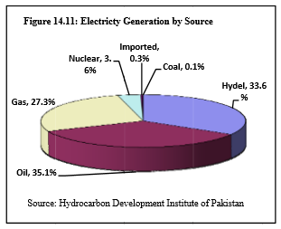

Slide 16
Alternative Energy
Alternative energy is often referenced as: any energy source that is an alternative to fossil fuel. These alternatives are intended to address concerns about such fossil fuels. For example, they typically pollute less among other supposed benefits.

Slide 17
Thank You

