Slide 1
ASTRONOMY
GENERAL SCIENCE & ABILITY
By CSS All in One

Slide 2
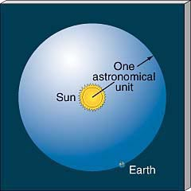
Definition
NASA defines astronomy as simple “the study of stars, planets and space.”
Astronomy and astrology were historically associated, but astrology is not a science and is no longer recognized as having anything to do with astronomy.

Slide 3
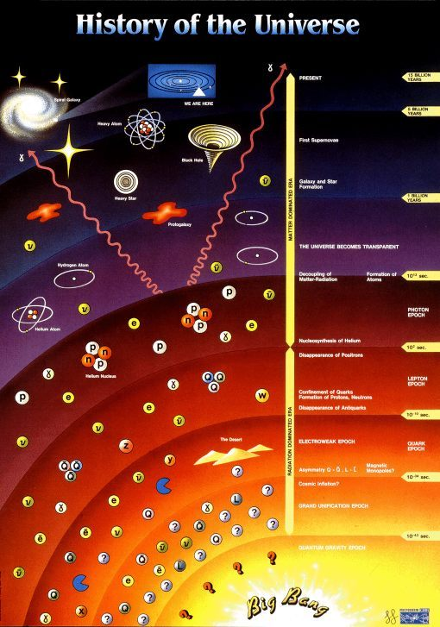
Universe
all existing matter, energy and space considered as a whole; the cosmos.
The universe is believed to be at least 91 billion light years in diameter and contains a vast number of galaxies; it has been expanding since its creation in the Big Bang about 13.7 billion years ago.

Slide 4
Astronomical units
Astronomical unit
Light year &
Parsec

Slide 5
Astronomical unit
One astronomical unit (AU) represents the mean distance between the Earth and our sun. The AU is approximately 150 million kilometers or 93 million miles. In 2012, the International Astronomical Union defined the distance to be 149,597,870,700 meters.
1 AU = 149,597,870.700 kilometers

Slide 6
Light Year
As defined by the International Astronomical Union (IAU), a light-year is the distance that light travels in vacuum in one Julian year (365.25 days) which is 9.4607 × 10¹² km
Because it includes the word year, the term light-year is sometimes misinterpreted as a unit of time.
The SI unit system defines the speed of light as roughly 3.00×10⁸ meter/second

Slide 7
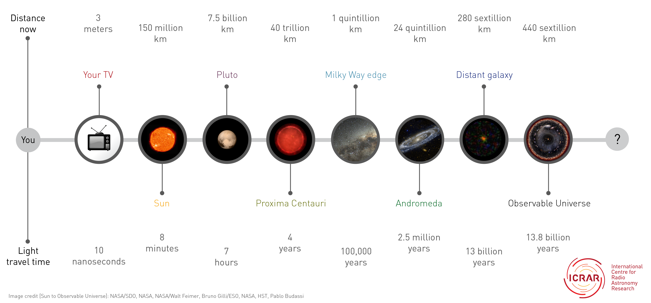
Light Year..

Slide 8
Parsec
One parsec is the distance at which one astronomical unit subtends an angle of one arc second.
The term parsec is a combination of 2 words, parallax (par) and arc second (sec). Parallax means something looks like it changed its location because you changed yours.
An arc second is 1/60 of an arcminute, 1/3,600 of a degree

Slide 9
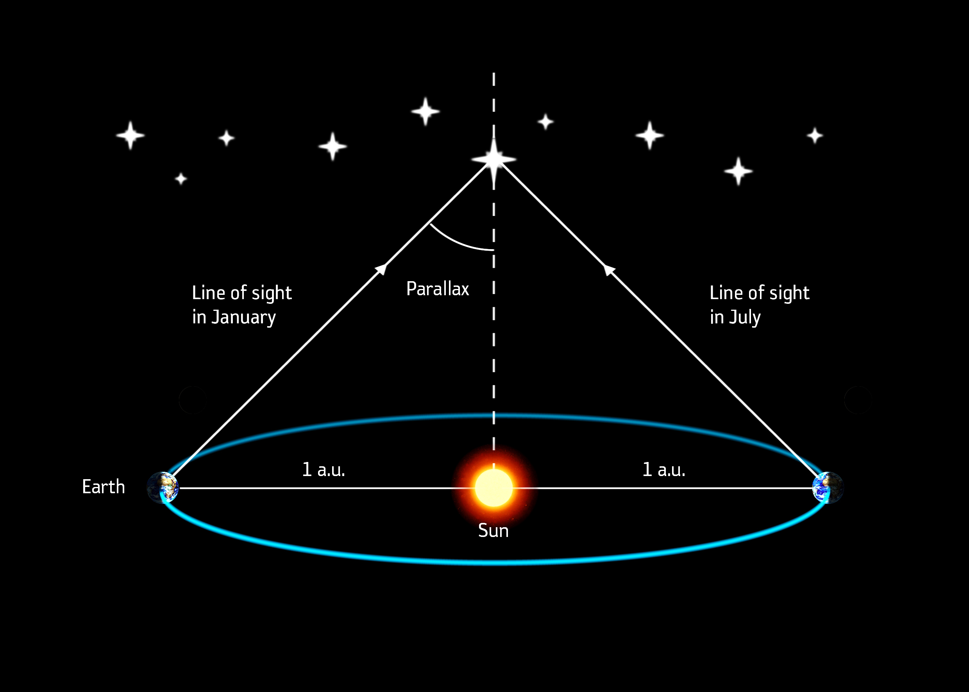
A parsec is equivalent to 3.26 light years, and since a light year is the distance light travels in 1 year 9.4 trillion km, 1 parsec equals 30.8 trillion km.

Slide 10
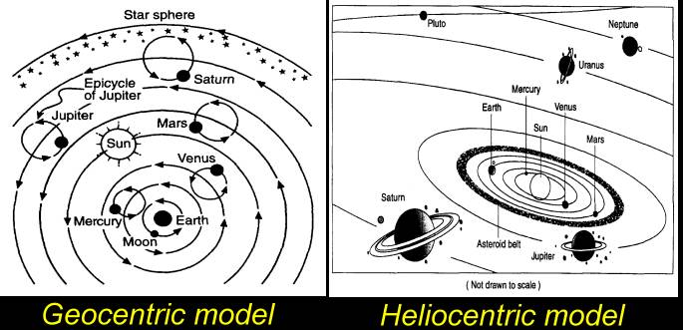
Models

Slide 11
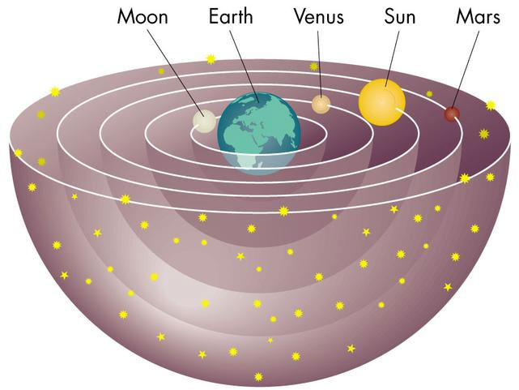
Earth-centered Cosmology: Claudius Ptolemy
Notes:
Big Idea: A geostatic model of the universe - centered around the Earth, and generally unchanging.
In this model the planets were considered to move within crystalline spheres. All spheres rotated once a day with the planetary spheres slipping slightly with respect to the outermost (starry) sphere, which accounts for their motions against the starry background. Comets were atmospheric effects caused by the friction of the innermost sphere against the upper atmosphere.

Slide 12
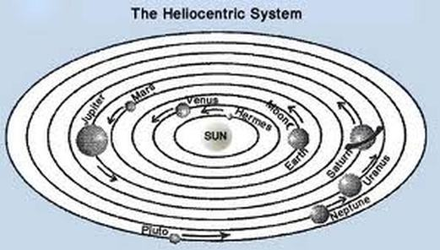
Sun-centered Cosmology: Nicolaus Copernicus
“At rest, however, in the middle of everything is the Sun.” Nicholaus Copernicus, de Revolutionibus

Slide 13
Origin and Fate of the Universe
This part of Astronomy is called Cosmology.
Cosmology seeks a scientific explanation for how the Universe began and how it might end (or will it go on forever?)
Cosmology is the study of the
Nature,
Structure,
Origin,
And fate of the universe

Slide 14
Steady State Theory
Opposes the Big Bang Theory
Steady State Theory states that the universe has always been essentially the same as it is today and that it will continue that way forever.

Slide 15
Steady State Theory
As matter moves apart, new matter is created to fill the gaps.
Cosmic Background Radiation in the universe ruled out the Steady State Theory.

Slide 16
Big Bang Theory
The Big Bang Theory was first proposed in the late 1920’s.
It states that there was an infinitely small, infinitely dense point that contained everything that is the universe.
This singularity was incredibly dense and hot.

Slide 17
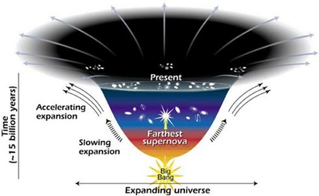

Slide 18
Big Bang Theory
The Big Bang is believed to have occurred between 10 and 15 billion years ago.
(Most scientists agree that the universe is 13.7 billion years old.)
The universe begins as the size of a single atom
The universe began as a violent expansion
All matter and space were created from a single point of pure energy in an instant
The early Universe was about 75% Hydrogen and 25% Helium. It is still almost the same today.

Slide 19
A summary of some of the evidence of the Big Bang and its interpretation
Evidence | Interpretation
The light from other galaxies is red-shifted. | The other galaxies are moving away from us.
The further away the galaxy, the more its light is red-shifted. | The most likely explanation is that the whole universe is expanding. This supports the theory that the start of the universe could have been from a singularity.
Cosmic Microwave Background | The relatively uniform background radiation is the remains of energy created just after the Big Bang.
Notes:
When objects are moving away from earth its light shifts to longer radiation, redder wavelength, an effect known as red shift
When object is moving towards earth its light shifts to shorter blue wavelengths known as blue shift.

Slide 20
Cosmic Microwave Background Radiation
Scientists discovered that there are microwaves coming from every direction in space. Big Bang theory says this is energy created at the beginning of the universe, just after the Big Bang, and that has been travelling through space ever since.
Long-wavelength radiation that fills all space.
Can be detected using special antenna. (1% of this can be detected in the static on your TV set.)

Slide 21
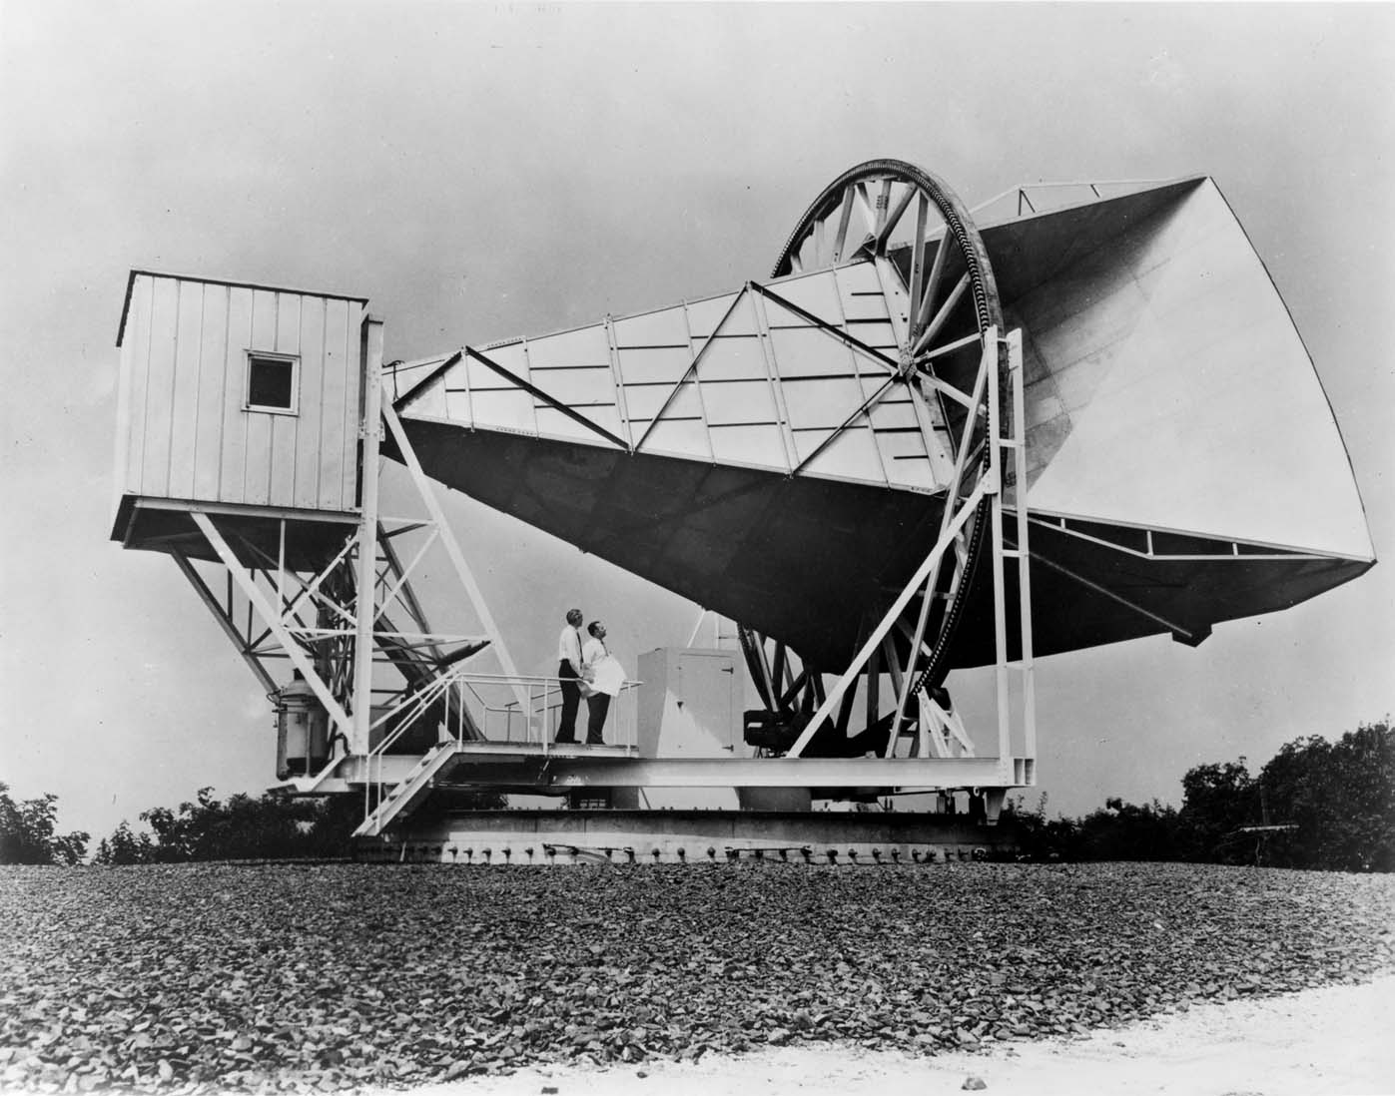
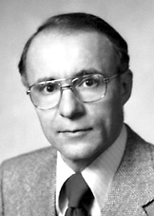
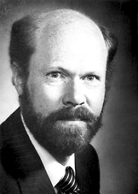
Bell Laboratories
Penzias and Wilson (1965) were radio astronomers who worked for Bell Telephone Laboratories.
Found a mysterious microwave signal causing background noise in their radio telescope.
The signal came from everywhere.
Arno Penzias Robert Wilson

Slide 22
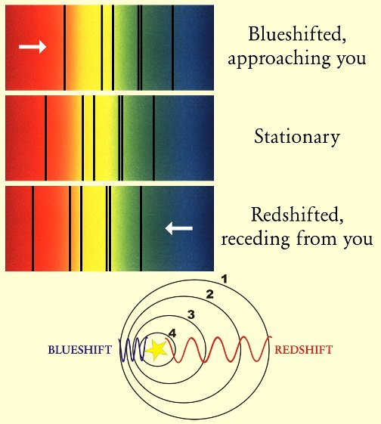
Red Shift Theory
Astronomers have found that the further from us a star is the more its light is red shifted. This tells us that distant galaxies are moving away from us, and that the further a galaxy is the faster it is moving away.

Slide 23
Misconceptions about the Big Bang
there was no explosion; there was (and continues to be) an expansion
Rather than imagining a balloon popping and releasing its contents, imagine a balloon expanding: an infinitesimally small balloon expanding to the size of our current universe
we tend to image the singularity as a little fireball appearing somewhere in space
space began inside of the singularity. Prior to the singularity, nothing existed, not space, time, matter, or energy - nothing.

Slide 24
Fates of the Universe
Open Universe
Closed Universe
Flat Universe
Cyclic Model

Slide 25
Fate of the Universe
Open Universe – little gravity that outward expansion goes on forever
Closed Universe – gravity will eventually halt the expansion and draw everything. Also known as the Big Crunch
Flat Universe – expansion slows down but never stops

Slide 26
Thank You
By CSS All in One

