Slide 1
Weather and Climates
General Science and Ability
For CSS and PMS

Slide 2
Introduction
Difference Between Climate and Weather.
Elements of Climate and Weather.
Climate Factors.
Other Factors.
World’s Climate and Classification.
Koppens Classification.
Climate Controls

Slide 3
What is climate?
Climate is the average weather conditions over a long period of time.
Includes average temperatures and precipitation, wind patterns, humidity, air pressure.
Weather is what it is NOW, climate is what it SHOULD BE.

Slide 4
How is this different from “weather”?
Weather changes day to day.
Weather can fall inside normal ranges or outside of what is expected from the climate- “above or below average”
Climate is the benchmark; what we expect

Slide 5
Elements of weather & climate
The state of the atmosphere at any particular place or time described using such elements or variables as:
1. Temperature
2. Precipitation (type)
3. Humidity
4. Cloudiness
5. air pressure
6. wind speed and direction

Slide 6
Temperature is how hot or cold the atmosphere is - ie, how many degrees Celsius (centigrade) it is above or below freezing (0°C)
farenheit and celsius scale

Slide 7
Precipitation is the term given to moisture that falls from the air to the ground
Pluviometer or rain guage

Slide 8
Atmospheric pressure (or air pressure) is the weight of air resting on the earth's surface. Pressure is shown on a weather map, often called a synoptic map, with lines called isobars.
Low pressure occurs when air becomes warmer. The air molecules expand, become lighter and it rises.
High pressure occurs when air becomes colder. The air molecules contract, become denser, heavier and sink towards the earth.

Slide 9
Barometer

Slide 10
Wind is the movement of air masses from high pressure areas (high) to low pressure areas (low). The effect of this movement of air is to rebalance the pressure in the atmosphere.

Slide 11
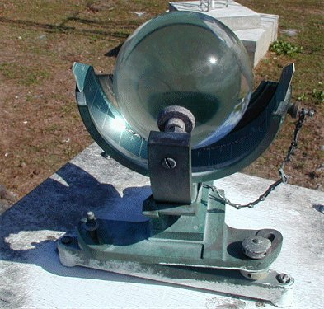
Sunshine
A note is made of the number of hours of bright sunshine each day
Sunshine is traditionally measured using a Campbell-Stokes sunshine recorder

Slide 12
Cloudiness
The amount of the sky obscured by cloud
Different types of clouds
Sometimes even the speed and direction in which the clouds are moving are recorded using a nephoscope

Slide 13
Climate Factors
Temperature Factors (LADBWOC!)
Latitude
Altitude
Distance to a Body of Water
Ocean Currents
Precipitation Factors (TP)
Topography
Prevailing Winds

Slide 14
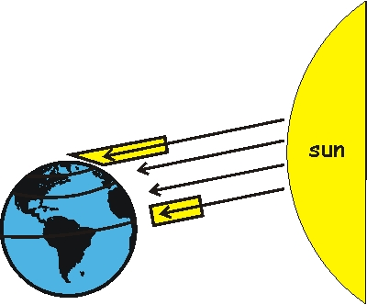
How does Latitude effect climate? (the angular distance N or S of the equator)
Latitude is the most significant factor for determining climate
Warmer at the equator
Colder at the poles – in general
Seasons are REVERSED between N. and S. Hemisphere

Slide 15
How does Altitude effect climate?
As you go up in altitude, you go down in temperature and sometimes precipitation

Slide 16
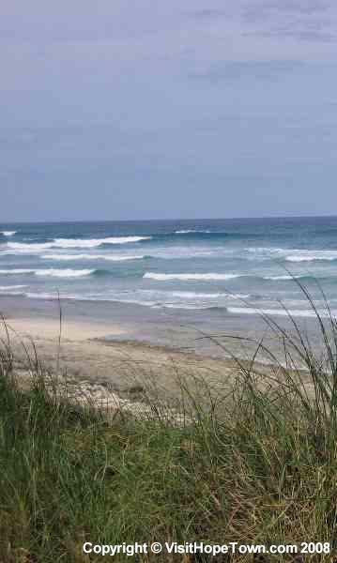
How does the Distance from large Bodies of Water affect climate?
Large bodies of water regulate temperature due to water’s properties.
The ocean thermostat- keeps it warmer in winter and cooler in the summer
less fluctuation
Inland climate have more extreme temperature fluctuations throughout the year

Slide 17
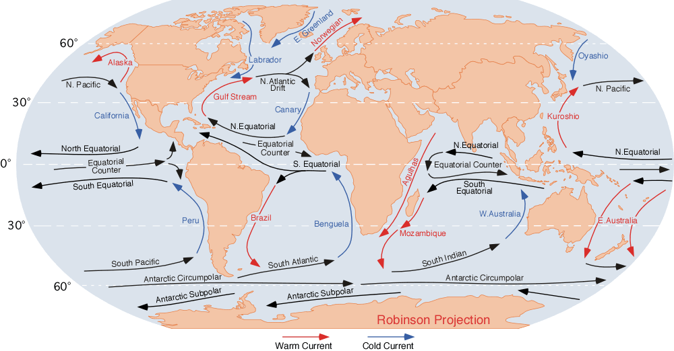
How do nearby Ocean Currents Effect the Climate?
Warm and cold ocean currents bring warm moist air near to coastal areas.
Great Britain is an example – latitude position puts it in the cold and dry climate zone
However it is moist and warmer due to the Gulf Stream, a warm current.

Slide 18
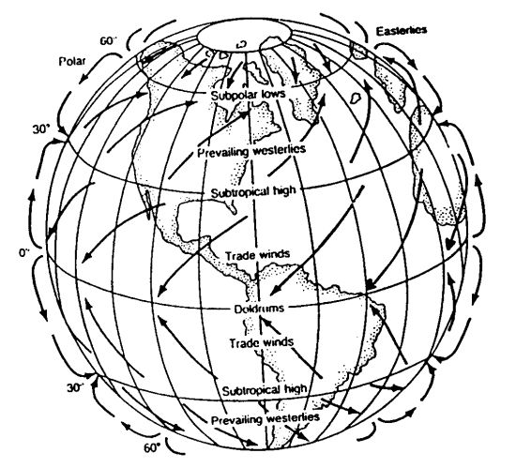
How do the Prevailing winds Effect climate? Prevailing winds are winds that blow predominantly from a single general direction over a particular point on the Earth's surface.
Global winds are generated by the rotation of the earth and move air around the globe.
Prevailing winds (like the Trade Winds) regulate climate
Winds bring storms, air masses of different temps.

Slide 19
How does Topography effect the climate?
The lay of the ground plays an important role in regulating climate
Ex. The windward side of a coastal mountain range is wetter than the leeward side – rain shadow effect

Slide 20
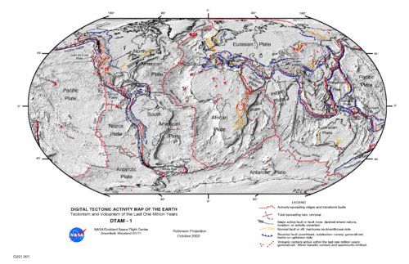
Other Factors- Plate Tectonics
Tectonic plates have shifted across Earth’s surface for billions of years
Greenland and Antarctica used to be tropical
S. Africa had glaciers
NJ had volcanoes
Most of the Western U.S. was underwater

Slide 21
Other Factors- Volcanic Eruptions
Volcanoes can warm AND cool the planet
Volcanoes emit CO₂ which is a greenhouse gas → global warming
But volcanoes also emit SO₂ and aerosols (tiny solid particles) that REFLECT sunlight back into space
Less radiation reaches Earth → COOLING

Slide 22
Ice Ages
Earth naturally fluctuates between ice ages and interglacial periods
ICE AGE- an era of cooler than normal global temperatures
INTERGLACIAL PERIOD- era of warmer than normal temps.
Scientists claim the next ice age is 50,000 years away

Slide 23
Thank You
CSS ALL IN ONE

Slide 24
World Climate and Koppen Classification
General Science and Ability
For CSS and PMS

Slide 25
World Climate
Climate is "the average state of the atmosphere".

Slide 26
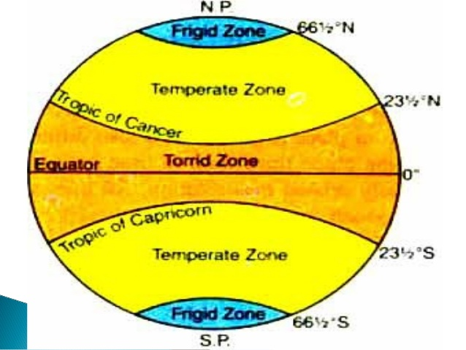
Climate Classification
Perhaps the first attempt at climate classification was made by the ancient Greeks, who divided each hemisphere into three zones: torrid, temperate, and frigid.
Since the beginning of the twentieth century, many climate-classification schemes have been devised.

Slide 27
Köppen Classification of Climate
For decades, a climate classification devised by Wladimir Köppen (1846–1940) has been the best-known and most used tool for presenting the world pattern of climates.
The Köppen classification uses easily obtained data: mean monthly and annual values of temperature and precipitation.
Furthermore, the criteria are unambiguous, simple to apply, and divide the world into climate regions in a realistic way.
Köppen believed that the distribution of natural vegetation was the best expression of an overall climate.
Consequently, the boundaries he chose were largely based on the limits of certain plant associations.

Slide 28
Köppen’s Classification Scheme
Köppen recognized five principal climate groups, each designated with a capital letter:
A (humid tropical),
B (dry),
C (humid middle-latitude, mild winters),
D (humid middle-latitude, severe winters), and
E (polar).
Four groups (A, C, D, E) are defined by temperature.
The Second, the B group, has precipitation as its primary criterion.

Slide 29
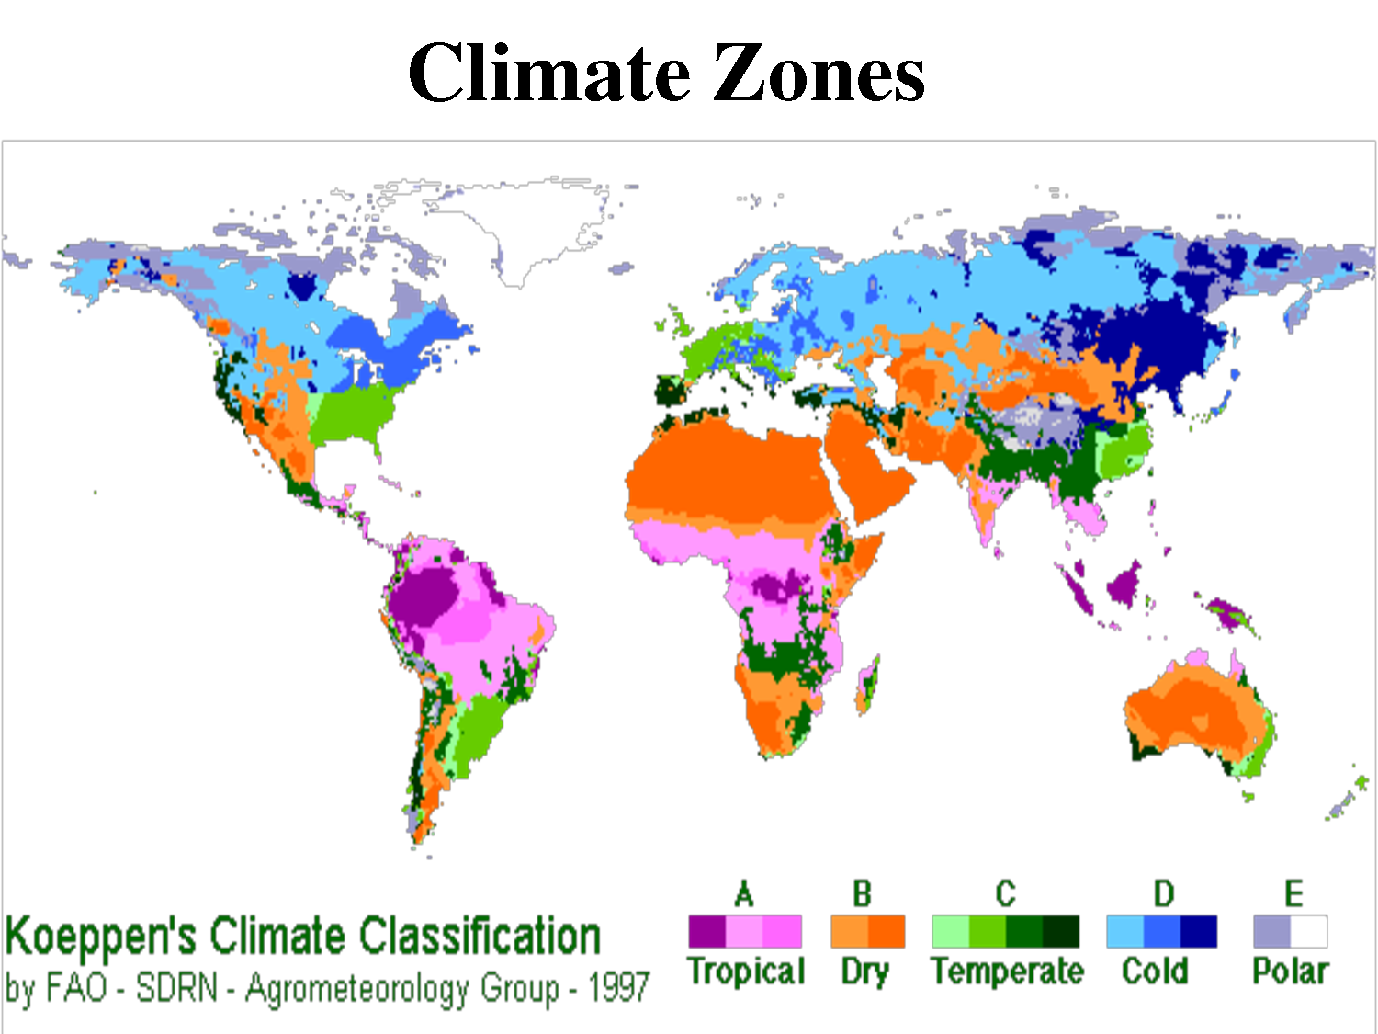

Slide 30
Climate Controls
Order exists in the distribution of climate elements and the pattern of climates is not by chance.
The world's climate pattern reflects a regular and dependable operation of the major climate controls.

Slide 31
Climate Controls (cont.)
The major controls of climate are:
(1) latitude (variations in the receipt of solar energy and temperature differences are largely a function of latitude),
(2) land/water influence (marine climates are generally mild, while continental climates are typically much more extreme),
(3) geographic position and prevailing winds (the moderating effect of water is more pronounced along the windward side of a continent),
(4) mountains and highlands (mountain barriers prevent maritime air masses from reaching far inland, trigger orographic rainfall, and where they are extensive, create their own climatic regions),
(5) ocean currents (poleward-moving currents cause air temperatures to be warmer than would be expected), and
(6) pressure and wind systems (the world distribution of precipitation is closely related to the distribution of Earth's major pressure and wind systems).

Slide 32
Type A Climate
Situated along the equator, the wet tropics (Af, Am) constant high temperatures and year-round rainfall combine to produce the most luxuriant vegetation in climatic realm—the tropical rain forest.
Temperatures in these regions usually average 25°C (77°F) or more each month and the daily temperature variations characteristically greatly exceed seasonal differences.
Precipitation in these climates is normally from 175 to 250 centimeters (68 to 98 inches) per year and is more variable than temperature, both seasonally and from place to place.
Thermally induced convection coupled with convergence along the intertropical convergence zone (ITCZ) leads to widespread ascent of the warm, humid, unstable air and ideal conditions for precipitation.
Notes:
ITCZ is a belt of low pressure which circles the earth near equator, where the trade winds converge with one another.

Slide 33
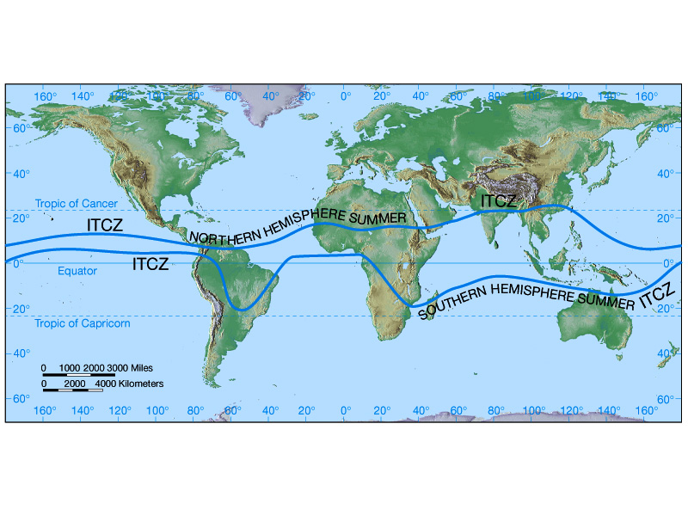

Slide 34
Type B Climate
Dry regions of the world cover about 30 percent of Earth's land area.
Other than their meager yearly rainfall, the most characteristic feature of dry climates is that precipitation is very unreliable.
Climatologists define a “dry climate” as one in which the yearly precipitation is less than the potential water loss by evaporation.
To define the boundary between dry and humid climates, the Köppen classification uses formulas that involve three variables:
(1) average annual precipitation,
(2) average annual temperature, and
(3) seasonal distribution of precipitation.

Slide 35
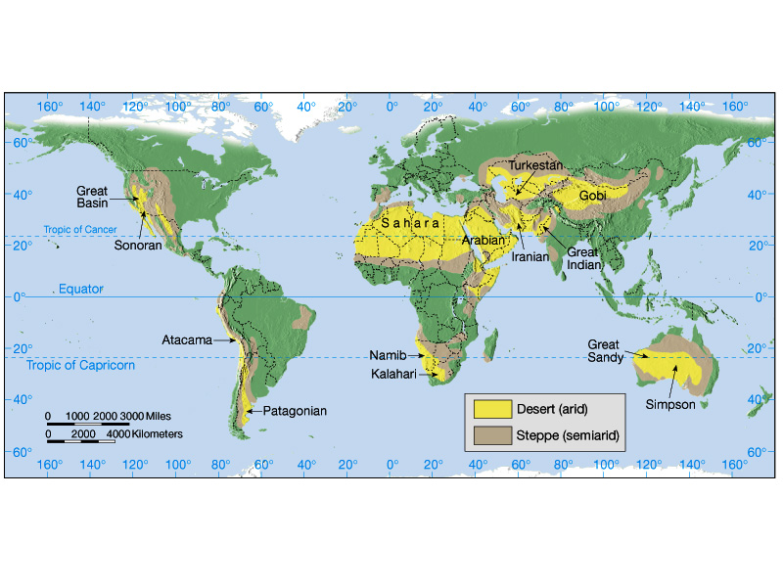

Slide 36
Type C Climate
Humid middle-latitude climates with mild winters (C climates) occur where the average temperature of the coldest month is less than 18°C (64°F) but above -3°C (27°F).
Several C climate subgroups exist.

Slide 37
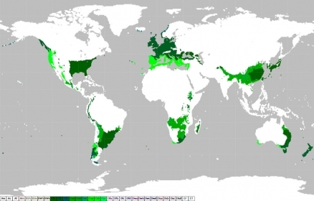

Slide 38
Type D Climate
Humid continental climates with severe winters (D climates) experience severe winters.
The average temperature of the coldest month is -3°C (27°F) or below and the average temperature of the warmest month exceeds 10°C (50°F).
The greatest annual temperature ranges on Earth occur here.

Slide 39
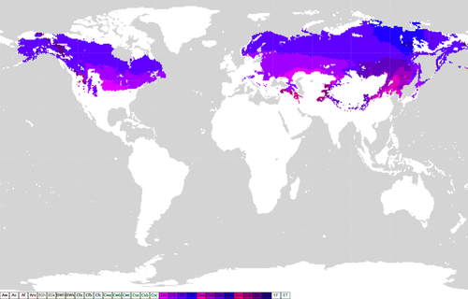

Slide 40
Type E Climate
Polar climates (ET, EF) are those in which the mean temperature of the warmest month is below 10°C (50°F).
Annual temperature ranges are extreme, with the lowest annual means on the planet.
Although polar climates are classified as humid, precipitation is generally meager, with many nonmarine stations receiving less than 25 centimeters (10 inches) annually.

Slide 41
Polar Climates
Two types of polar climates are recognized.
Found almost exclusively in North America, the tundra climate (ET), marked by the 10°C (50°F) summer isotherm at its equatorward limit, is a treeless region of grasses, sedges, mosses, and lichens with permanently frozen subsoil, called permafrost.
The ice cap climate (EF) does not have a single monthly mean above 0°C. Consequently, the growth of vegetation is prohibited, and the landscape is one of permanent ice and snow.

Slide 42
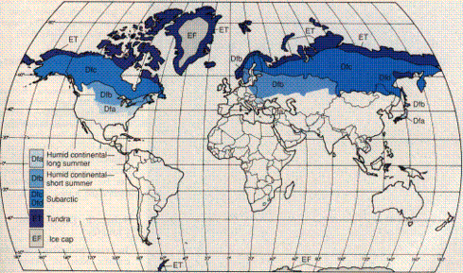

Slide 43
Highland Climates
Highland climates are characterized by a great diversity of climatic conditions over a small area.
In North America, highland climates characterize the Rockies, Sierra Nevada, Cascades, and the mountains and interior plateaus of Mexico.
Although the best known climatic effects of an increased altitude are lower temperatures, greater precipitation due to orographic lifting is also common.
Variety and changeability best describe highland climates.
Because atmospheric conditions fluctuate with altitude and exposure to the Sun's rays, a nearly limitless variety of local climates occur in mountainous regions.

Slide 44
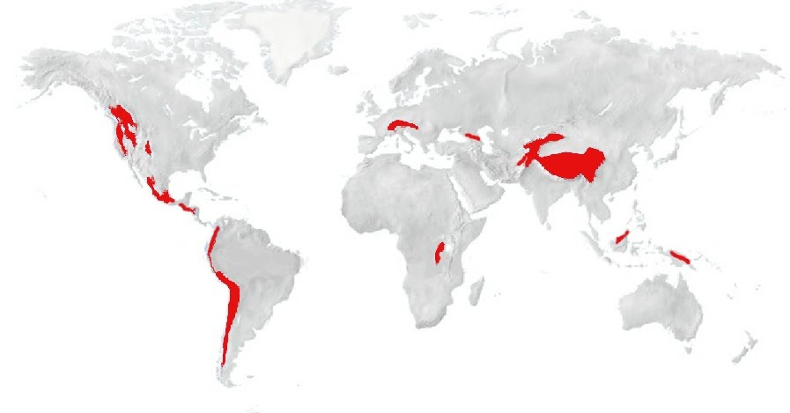

Slide 45
Thank You
CSS ALL IN ONE

